Slide 1
„HOW TO MAKE MONEY AND DON‘T TAKE IT“
The cheapest milk is the one you milk from your bulky feed
Dr. Jiří Krátký

Slide 2
Rumen stability
Healthy animals
Stress of farmer
Quality of silage
Toxins
Costs of veterinary services
Fertility
Costs of compound feeds

Slide 3
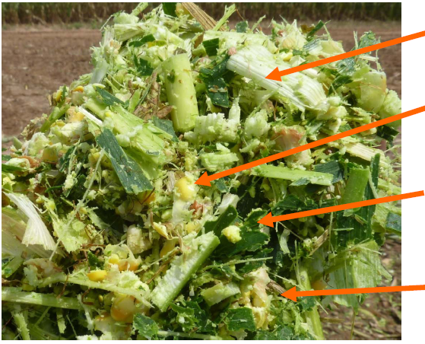
Requirements of dairy cows:
Structural fiber required
High NDF digestibility
Proper grain disruption,
starch and energy utilization
Clamping / compressibility, ability of ensiling
Homogeneous material with the large surface area
Cows like a sweet taste
3
Notes:
3

Slide 4

Good quality silage increases fiber (NDF) digestibility
Cows respond to any 5% increase in NDF digestibility:
Increase of DMI (dry matter intake) by + 0,63 kg
Increase of avg. daily milk prouction by + 0,9 kg
(Oba & Allen 1999, Jung et al 2004, Ferraretto & Shaver 2013)

Slide 5
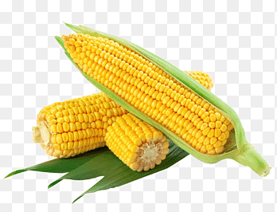
Silage production
When does it start ?
→ agrotechnics, field work
→ the road to the dairy starts in the field
When does it end ?
→ by picking / loading and feeding

Slide 6
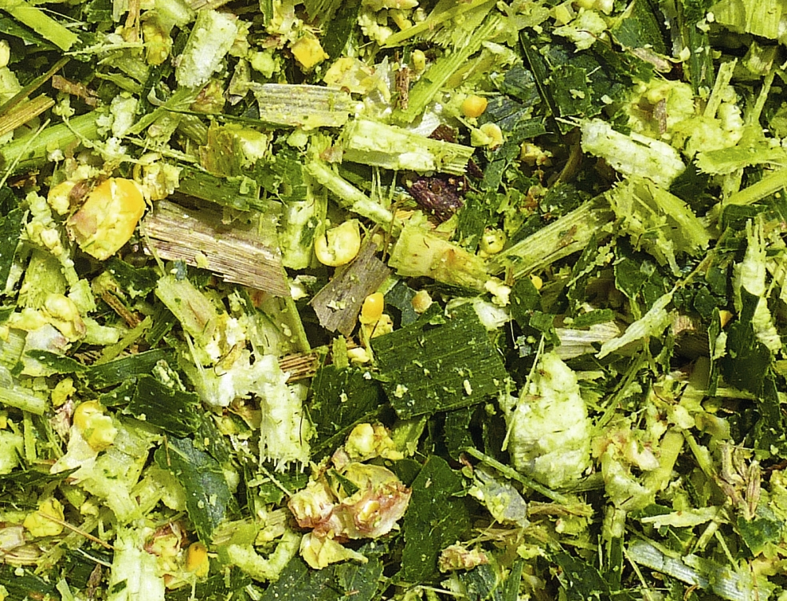
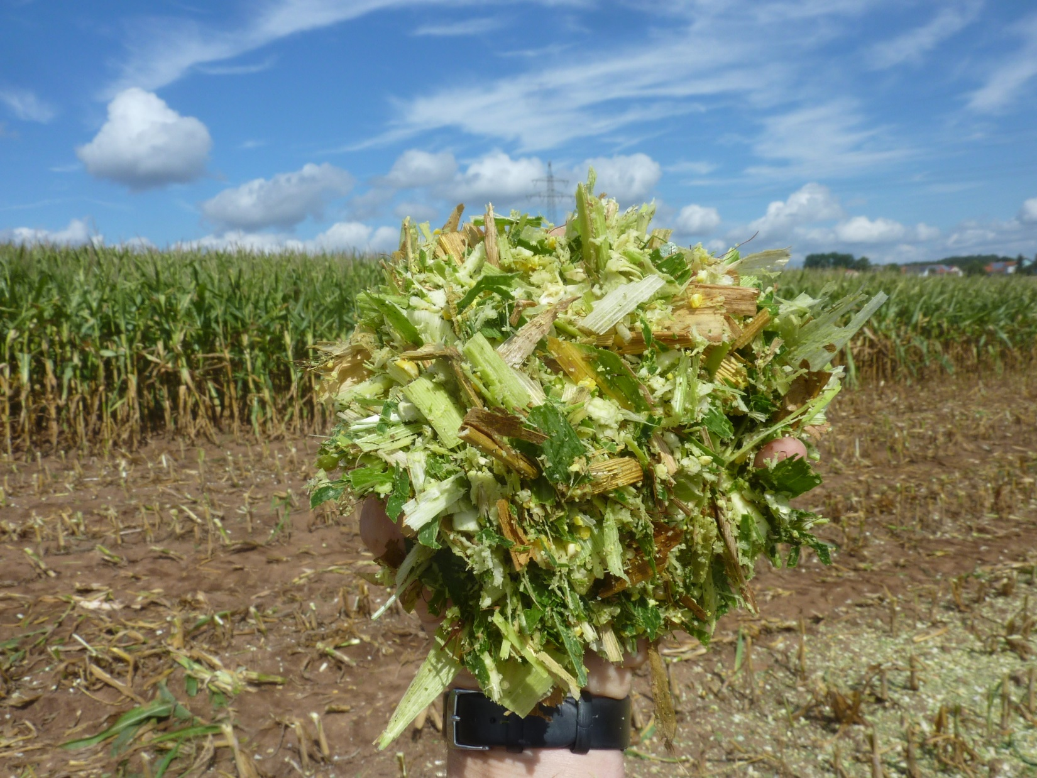
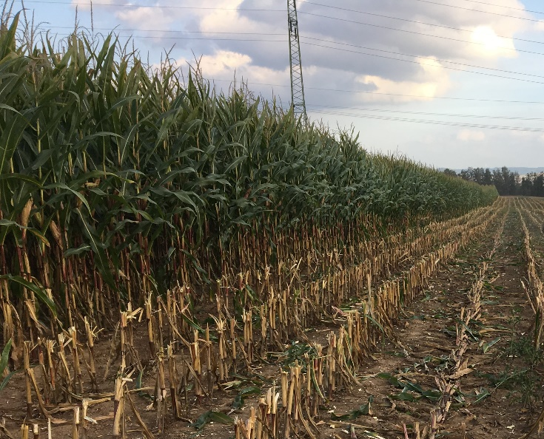
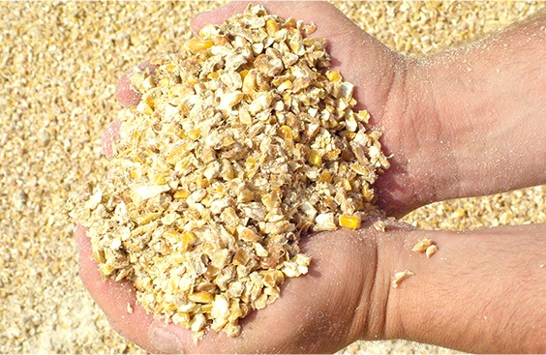
Corn silage production
1.
Corn silage – most often types
1. corn silage („standard“)
2. shredlage
3. high moisture corn (CCM)
2.
3.

Slide 7
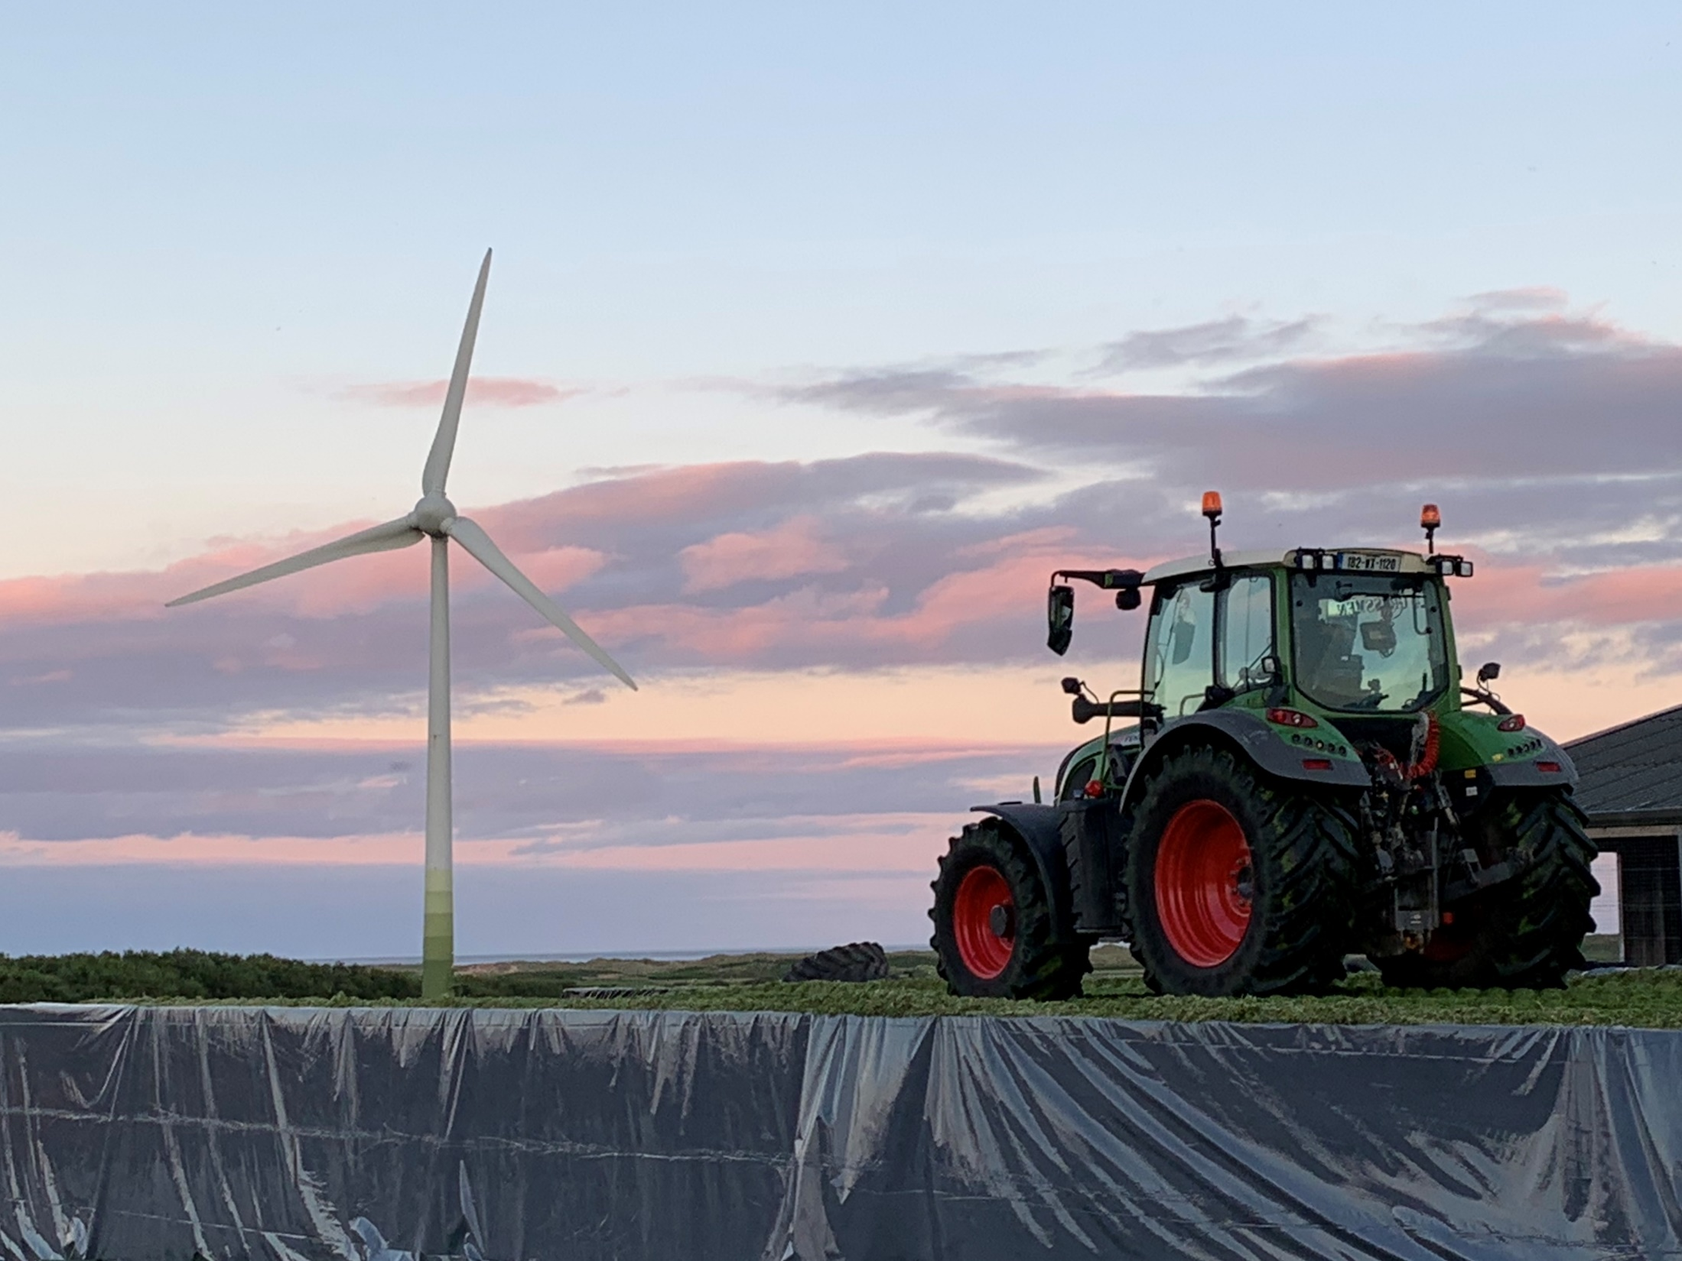
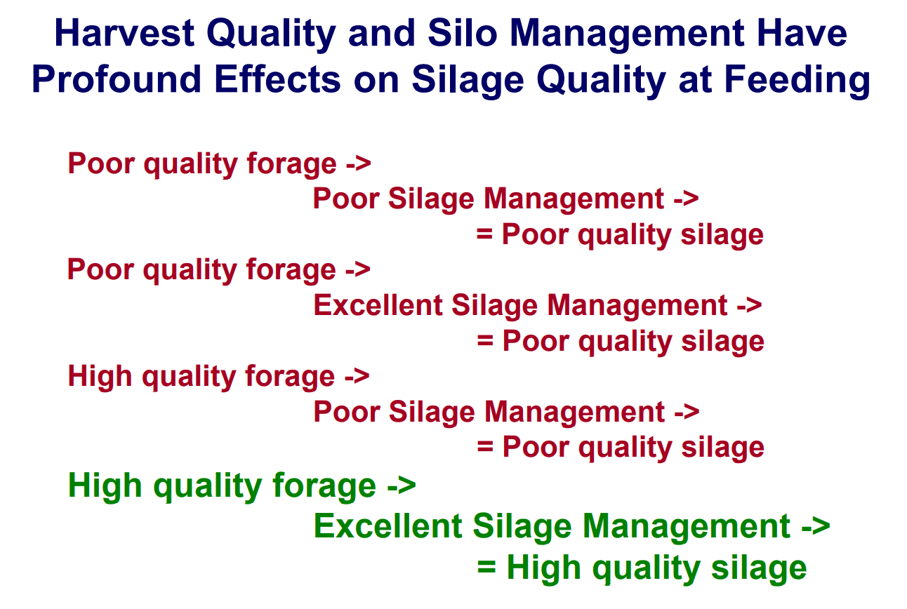
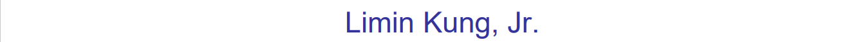
Notes:
High quality, low losses, high losses

Slide 8
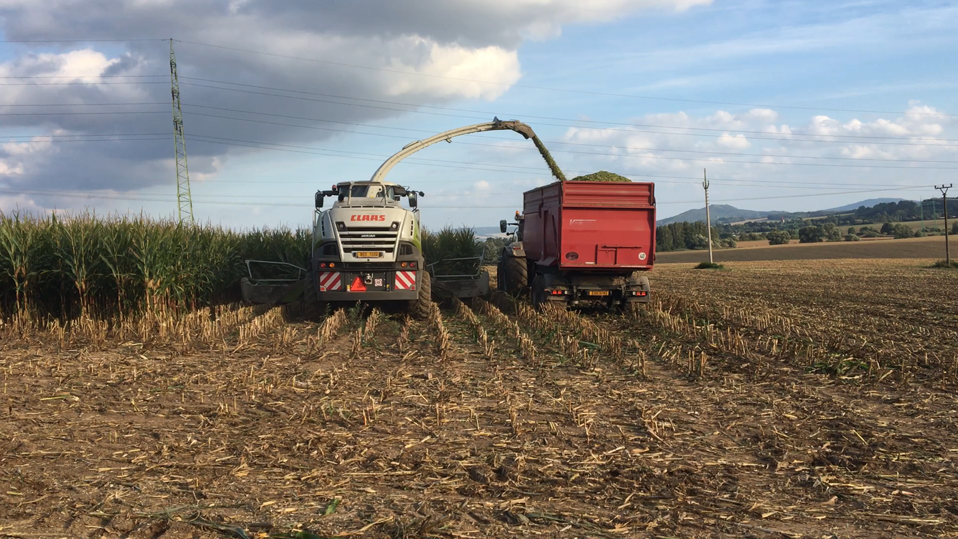
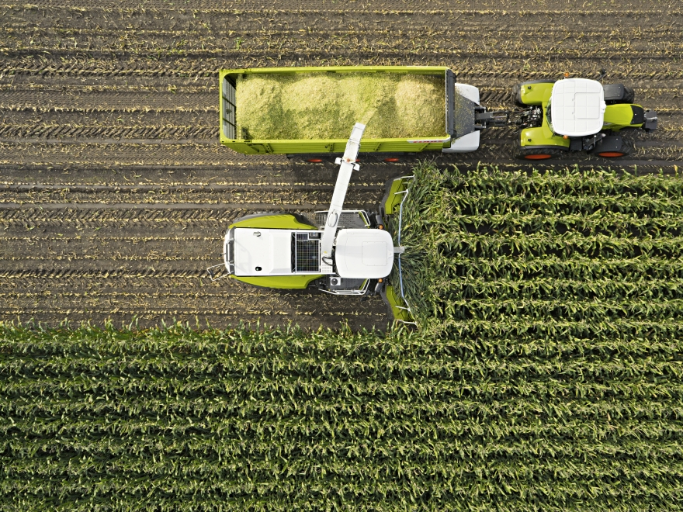
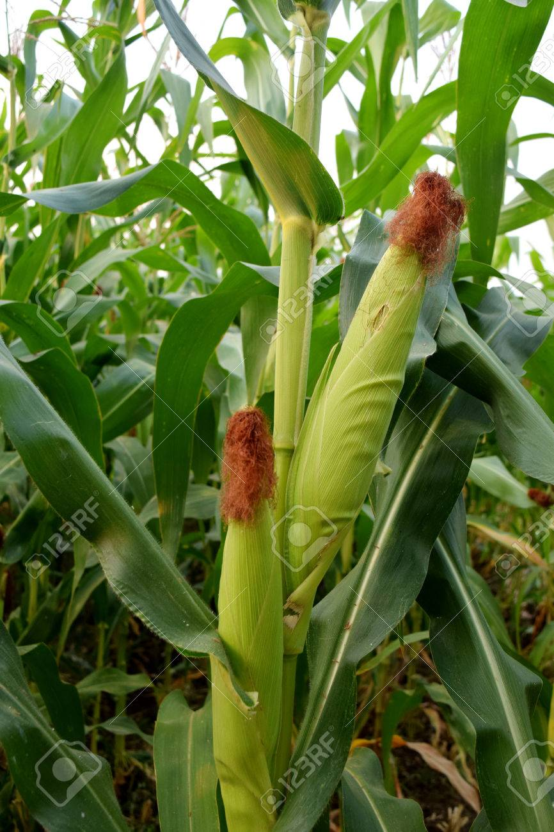
Harvest – day „D“
goal ➔ harvest crop at the
optimal maturity stage and
ideal dry matter and
preserve it for several months

Slide 9
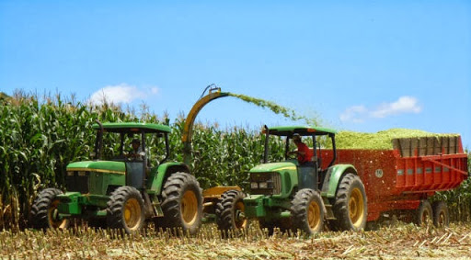
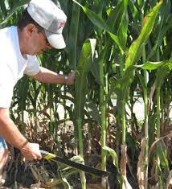
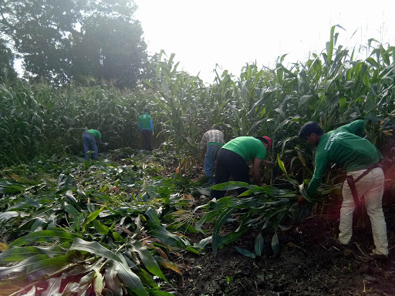
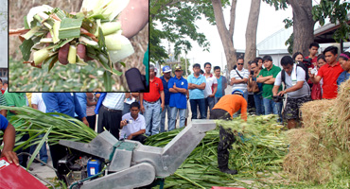
Harvest – day „D“

Slide 10
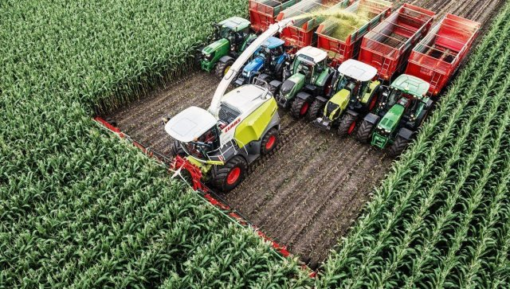
Harvest – day „D“
Harvesting 20 rows of corn all at once
Kemper adapter, width shot of cutter 15 m !!!

Slide 11
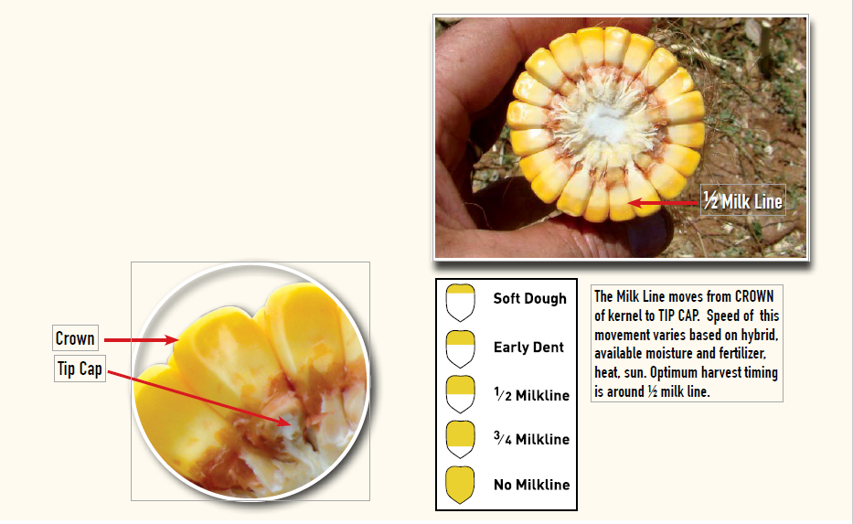
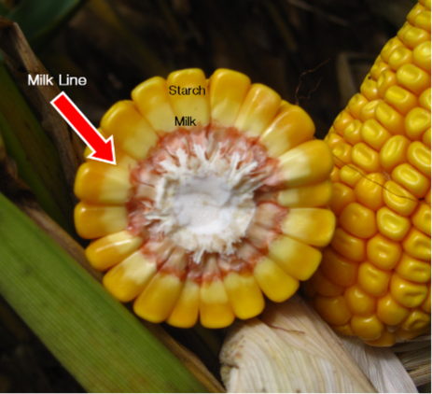
Optimal maturity, dry matter and cut length
Optimal maturity: milk-wax stage of grain
Absolut min. cut length - 8 mm
➔ rumination
Corn silage | Optimal dry matter | Optimal cut length
Standard | 32 – 33% | 10 – 15 mm
Shredlage | 32 – 35% | 22 – 30 mm

Slide 12
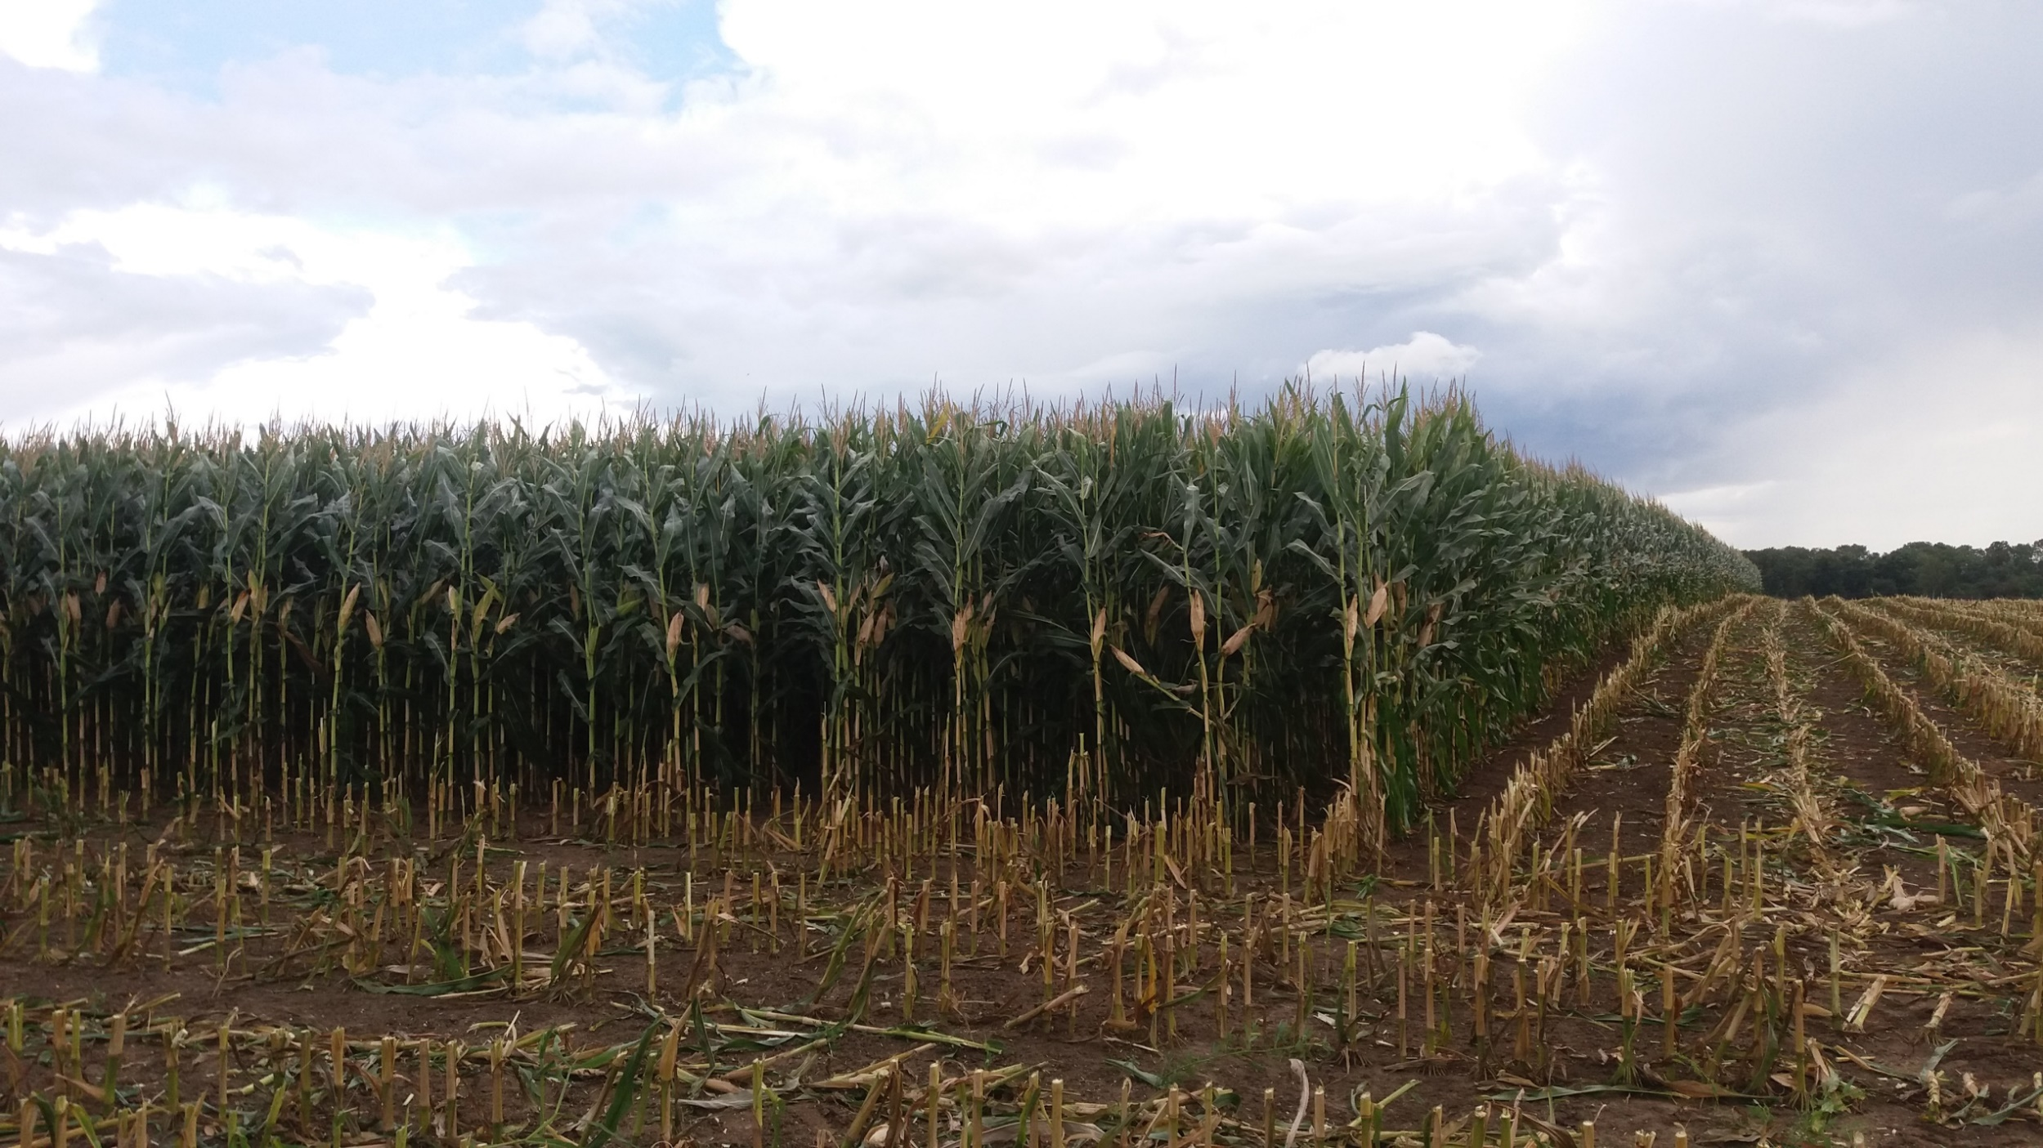
Corn harvest stage
Dry matter of the whole plant 32 – 33%
- from it dry matter of corn cobs 45 – 55%
- dry matter of grain 60 – 65%
- the rest of plants without cobs 24 – 25%
At this stage, the storage of nutrients, especially starch and sugars, is completed.
At this stage – the highest fibre digestibility
Cows like a sweet taste

Slide 13
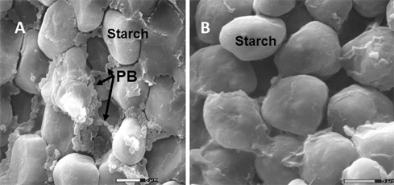
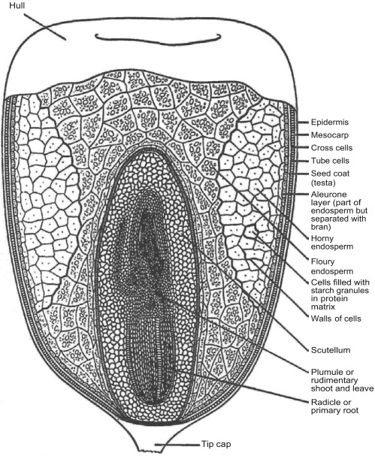
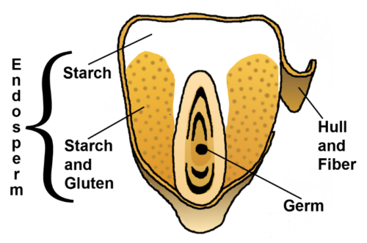
Corn harvest stage
Dry matter of the whole plant 32 – 33%
→ the best energy efficiency of corn silage
- zein – gluten is protein forms internal structure of corn kernel
- the protein coats the starch granules
- the protein limits swelling and fermentation of starch in the rumen if DM of the whole plant > 35%

Slide 14
Corn harvest stage
Dry matter of the whole plant >35%
- less sugars
→ much slower fermentation of silage
→ lower palatability for cows – lower feed intake
- more starch but lower fermentability of starch in the rumen
→ more starch by-pass the digestive tract and ends in manure
- rapidly declining fiber digestibility
→ fast lignification of plants
Cows like a sweet taste

Slide 15
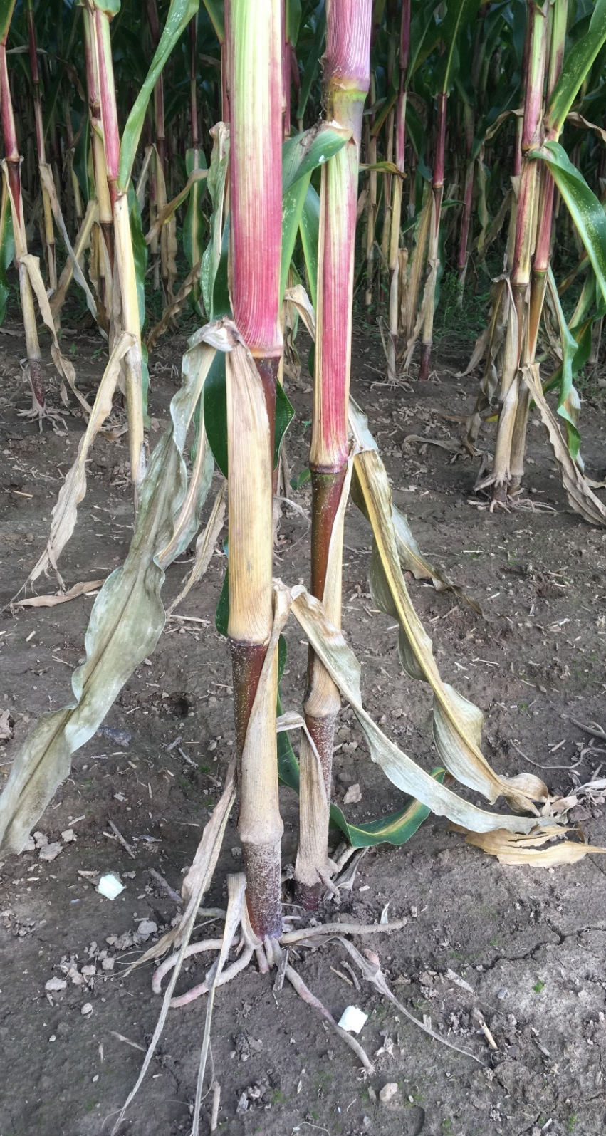
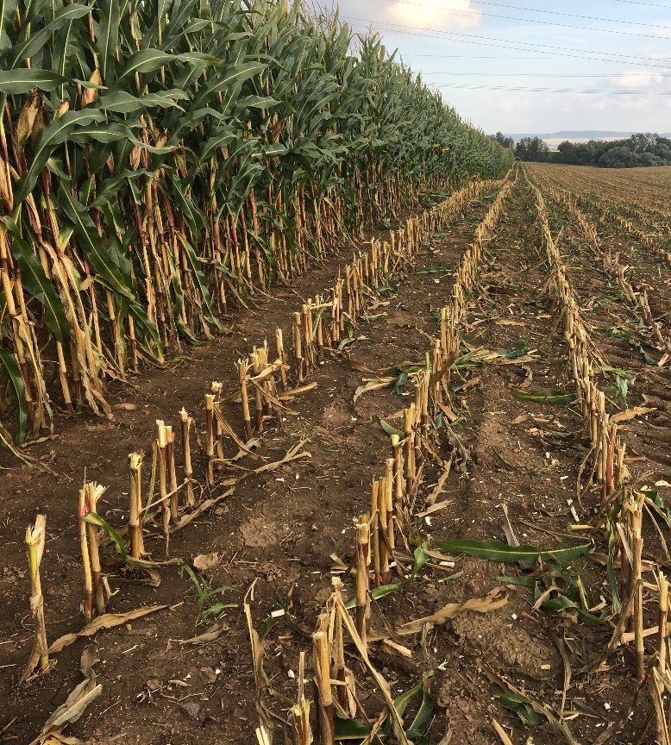
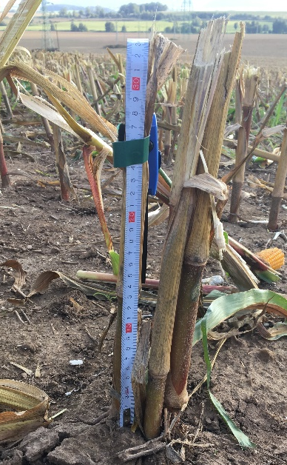
Stubble
corn 30 – 50 cm
☞ NO soil contamination
☞ NO yeast + undesirable bacteria Clostridium
☞ NO undigestible parts full of lignin
Minimal height 30 cm

Slide 16
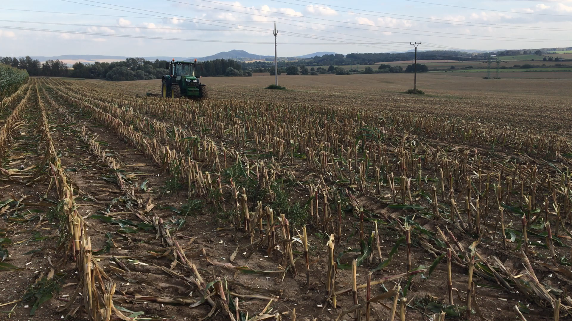
Practical tool – just behind the harvestor - mulcher

Slide 17
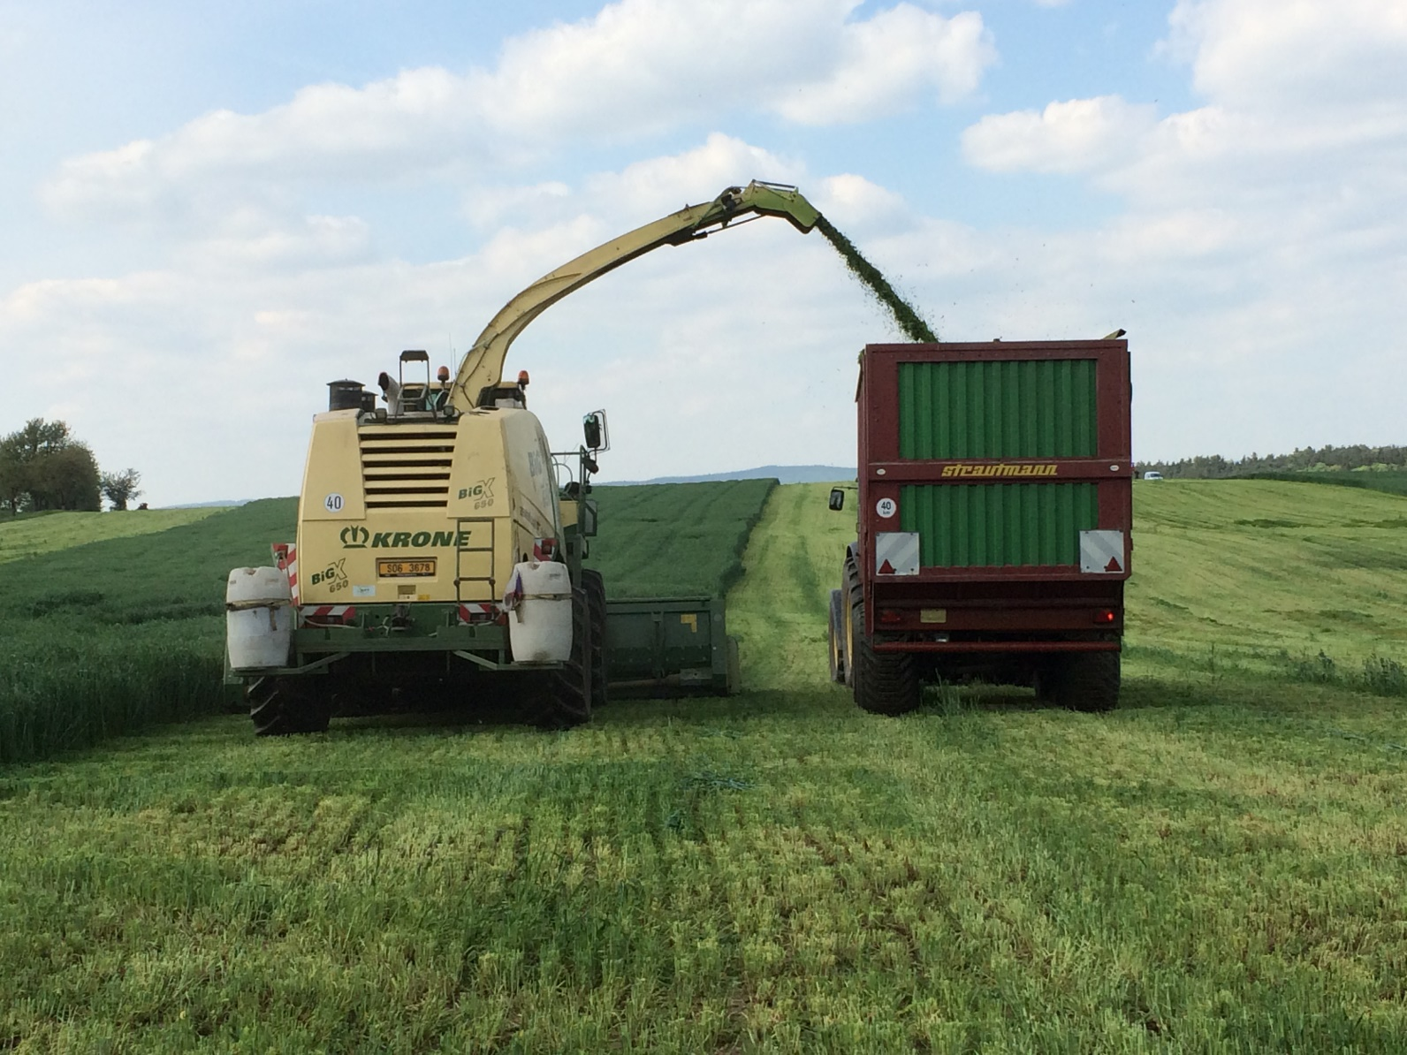
WE MUST CONTROL
THE FERMENTATION PROCESS

Slide 18
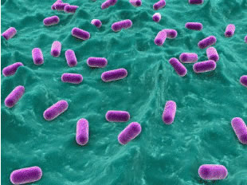
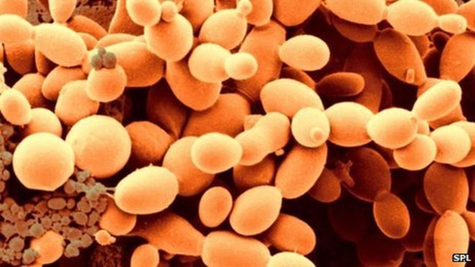
Fermentation and Maturation of Silage
enzymes from Formasil inoculants – produce sugars/energy for LAB bacteria
bacteria from Formasil inoculants – produce lactic acid which preserves silage
Driven bacterial fermentation – FORMASIL®
Drop of acicidy in the preserved mass - silage
pH ↓ to 4,2 (4,0 – 4,5) within 5-6 days after cover
lactic acid fermentation will not start until all air with oxygen is removed from ensiled crop
Maturation – minimum 6 weeks to achieve STABILITY
opening silage pit to early – risk of spoilage and losses
secondary fermentation
– yeasts: non-visible process, high warming of silage above ambient temperature
➔yeasts destroy silages as the first
– molds: change of color - when visible (black color or white spots), it is already too late
Biological process
Anaerobic environment
Oxygen!

Slide 19
Formasil®
Private registered brand of the silage inoculant product line
Specially selected strains of bacteria
High enzymes activity
Increases the silage palatability + DMI
Suitable even for „older“ vegetation
Effective even at higher dry matter
Increases aerobic stability at the feedout time – direct effect
of Lactobacillus buchneri 40788 (patented)
Formasil | Grass, clover-gras
Formasil Alfa | Alfalfa, clover (high crude protein)
Formasil Cool | 1st cut (rezidual sugars – aerobic stability) Higher dry matter – aerobic stability
Formasil Maize | corn

Slide 20

Formasil® MAIZE
CORN SILAGE
Biological inoculant for corn silage preservation
Contains 2 types of bacteria that complement each other
Pediococcus pentosaceus NCIMB 12455
Lactobacillus buchneri NCIMB 40788
Bacterial ferments inhibit yeasts and molds
Yeasts and molds cause aerobic unstability, spoilage
Easy to use: dilution and aplication
The solution usable for 48 hours.

Slide 21
It is not a presservative as a preservative Sil-All vs Formasil Maize
Which silage is better?
Sil-All – worse analytical parameters, but lower cost of treatment per ton ($ 0,4/ton)
Formasil Maize
- better parameters
- more sugars, less undigestible fibre
- higher palatability
- higher content & better ration of acids
- slightly higher costs of treatment per ton ($ 0,93/ton)
cost of preservative per ton of treated silage is the marginal cost
The price of the unit of RFV relative feed value is decisive:
RFV value
- prediction of feed digestibility and feed usability
- prediction of milk production from the feed
- 1 ton of corn silage = $ 43
Sil-All:
RFV = 149,1
1 RFV = 0,289 USD
Formasil Maize:
RFV = 170,47
1 RFV = 0,252 USD
Cows like a sweet taste
The RFV value is economically advantageous when using Formasil Maize

Slide 22
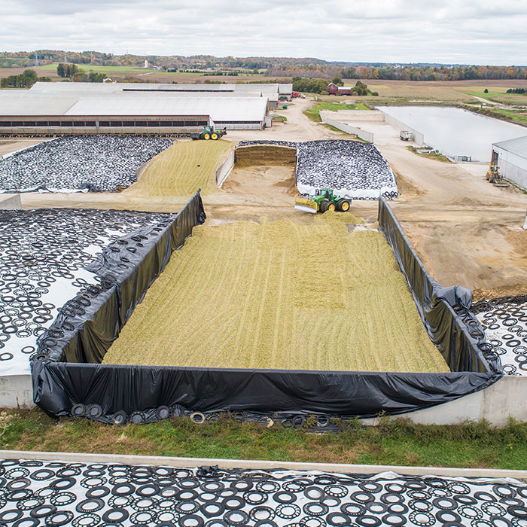
Take home message
Late harvest always means:
- WE ALWAYS LOSE MONEY
- lower milk production – less money for milk
- we buy raw materials – higher costs
- maybe more mass per hectare, BUT ?
- less sugars (fermentation, DMI)
- lower starch utilization
- higher NDF content
- much lower NDF digestibility
→ need to buy raw materils to cower energy requirements
→ need to pay – extra costs
→ prices are rising
→ inflation
Cows like a sweet taste

Slide 23
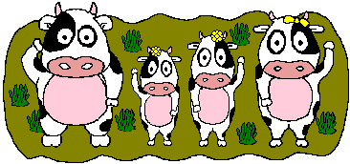
Thank you for your attention

